Slide 2




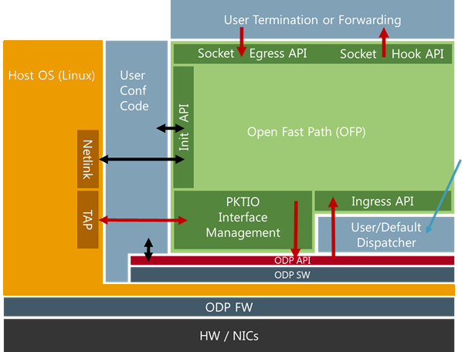
What is Open Fast Path (OFP)?
IP fast path incubation project between Nokia, Enea and ARM
Developers and supporting staff active from all three companies
API’s towards hardware is based on ODP (Open Data Plane)
Maximizes portability and software reuse
”Democratic” governance model
Decisions made in weekly meetings and logged in the google docs
Organized as an Open source project
Using open source software
BSD license
Source code on GitHub
Mailing list, shared Google docs, weekly calls, Freenode chat etc
Notes:
IP + UDP from Nokia ufp
TCP from freeBSD

Slide 3
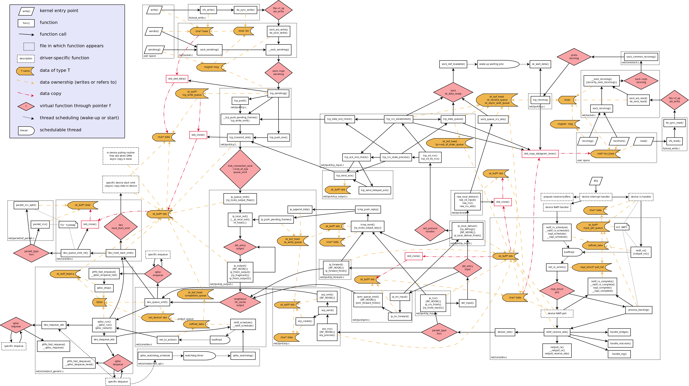
Why is an Open source IP fast path stack needed?
The amount of data that needs to be managed increases exponentially
HW supports multiple 10G and 40G interfaces today, with 100G coming in a near future
As the average device core count goes up, application scalability becomes more important
Many networking systems are built on Linux
Linux TCP/IP stack is mainly developed for features, not for performance
Limitations such as scheduling pre-emptions, timers, locks, RCUs, etc. impacts throughput and scalability
The Linux TCP/IP stack is complex and implemented in kernel space
Feature extensions and modifications are difficult
Very few open source fast path alternatives available – none on ODP

Slide 4
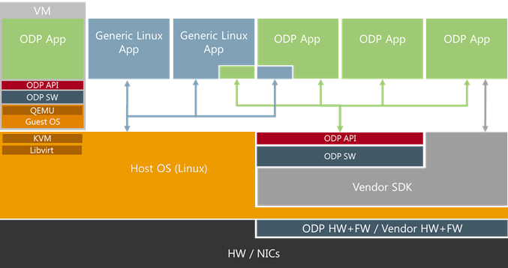
Why base the OFP stack on ODP?
Standardized data plane API to enable networking applications across any architecture
Open support for ARM, Intel, MIPS, PowerPC, RTOS, Linux, bare metal
Designed to be an generic yet high performance data plane abstraction layer
Lightweight without prescribing lower level processing structure which can be vendor specific
Access and management of HW accelerators and classification
Supports optional schedulers to provision easy management and traffic load balancing
Defined to enable high throughput user plane applications
Run to completion
Core isolation (only 1 work thread per core scheduled by ODP)
Minimal use to no use of Linux APIs
Major TEM’s onboard - Nokia, Ericsson, Huawei, ZTE and others

Slide 5
OFP Source code
New open-source code
Developed by partners during the incubation stage
UDP, TCP, ICMP code was ported from libuinet (Userland FreeBSD port)
Non-blocking event based API
Focused on performance and scalability
Tightly coupled to application
Maintainability – Tracks evolution of FreeBSD
Highly scalable code for MAC and Route lookup tables
All structures and functions calls have an “ofp” prefix: ofp_socket(), struct ofp_sockaddr

Slide 6

Open Fast Path components
NICs
ODP
Packet processing
Application
API
API
API
Routes, ARP
Linux kernel
IPv4
IPv6
API
TAP
MAC
Netlink
Application
OFP
Interface configuration
API
ODP API
Linux
Configuration Packets Information
ODP
CLI
HW
Notes:
Command line interface (CLI): Internal Command Line Interface to configure and debug OIP-FP.
Packet handler: Received packet handling.
Init: ODP environment, and internal memory initialization.
Netlink: Copies routes and interfaces from Linux.
TUN/TAP: Communication with Linux kernel, slowpath.
Port configuration: Ethernet interface functionality.
Route, arp: Route and ARP functions.
Application API: Function calls for configuration, packet processing, logging, etc...
AVL and Radix trees: Functionalities to be used by other modules.
Socket: BSD style socket interface
Protocols: UDP, TCP, UDP6, ICMP implementation

Slide 7
OFP System View
User Termination or Forwarding
Socket Egress API
Socket Hook API
Host OS (Linux)
User ConfCode
Init API
Open Fast Path (OFP)
Netlink
buf = odp_queue_deq(queue);
or
buf = odp_schedule(&queue, ODP_SCHED_WAIT);
Route tables
Slow path
TAP
PKTIO
Interface Management
Ingress API
Application
User/Default Dispatcher
OFP
ODP API
Linux
ODP API
ODP
ODP SW
HW
ODP FW
Ctrl
HW / NICs
Packets

Slide 8
Open Fast Path multicore System View
User Termination or Forwarding
User Termination or Forwarding
User Termination or Forwarding
Socket/Hook API
Socket/Hook API
Socket/Hook API
Host OS (Linux)
User ConfCode
Open Fast Path (OFP)
Open Fast Path (OFP)
Open Fast Path (OFP)
….
Route tables
Netlink
Init API
Init API
Init API
Slow path
TAP
PKTIO
Ingress API
PKTIO
Ingress API
PKTIO
Ingress API
Dispatcher
Dispatcher
Dispatcher
….
ODP API
ODP API
ODP API
ODP SW
ODP SW
ODP SW
….
Application
Core 1
Core 1
Core 2
Core N
OFP
ODP API
ODP FW/HW
Linux
NICs
ODP
HW

Slide 9
User application APIs
Initiation of Open Fast Path
Interface configuration
Route and MAC table access
Packet Ingress and Egress processing
BSD/POSIX “like” socket interface:
Legacy mode select/send/recv callback (NOT zero-copy)
Signal event + custom sigval with odp_packet_t and socket
Hooks for IP local, IP forwarding and protocol level extensible.
Timer callbacks
Statistics
Packet capture

Slide 10
Ingress Packet Processing
IP, UDP, TCP, … classified by HW
IPv4/v6
IPv4 local hook API
UDP input
Socket API
Transport(L4) classifier
TCP input
IPv4 Reassembly
IPv4 forward hook API
ICMP
Ingress API
Ethernet
Vlan
IPv4 GRE
GRE hook API
IPv4/v6 routing
IPv4/v6 output
User API
Fallback to slowpath for unknown traffic
L4
Update MAC table
ARP
L3
L2
Send ARP request
Pre-classified
Packets Information

Slide 11
Egress Packet Processing
UDP output
TCP output
IPv6 output
Socket/Egress API
IPv4 output
IPv4 Fragmentation
Ethernet
Vlan
User API
ICMP error
L4
IPv4 GRE tunneling
L3
L2
Pre-classified
Packets Information

Slide 12
Features implemented
Fast path protocols processing:
Layer 4: UDP termination, TCP termination, ICMP protocol
Layer 3
ARP/NDP
IPv4 and IPv6 forwarding and routing
IPv4 fragmentation and reassembly
VRF for IPv4
Layer 2: Ethernet, VLAN
GRE Tunneling
Routes and MACs synced from Linux
Integration with Linux Slow path IP stack
Command line interface
Packet dumping and other debugging
Statistics, ARP, routes, and interface printing
Configuration of routes and interfaces with VRF support

